Slide 1
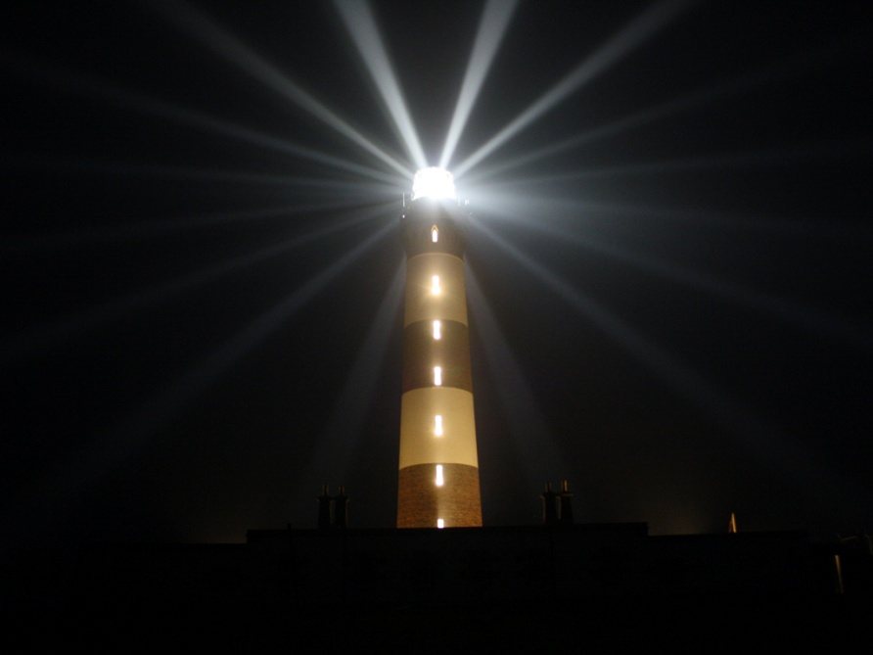
Non-violence of States Best practices
Christophe Barbey, APRED, IPRA 2014

Slide 2
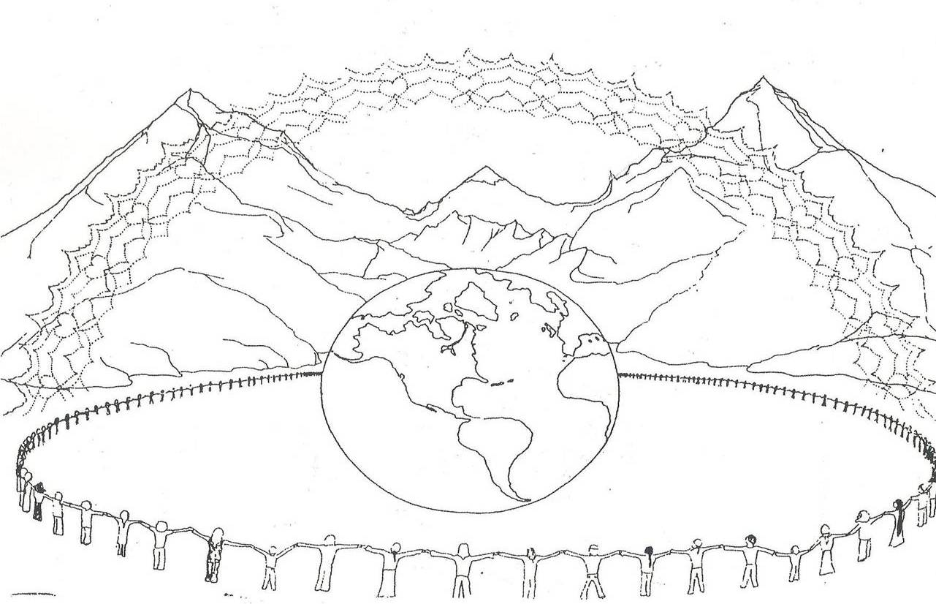
Christophe Barbey, APRED, IPRA 2014

Slide 3
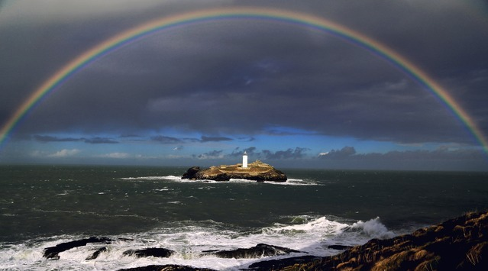
Tools of peace for institutions
Peace as a human right
Peace and democracy
Peace in constitutions
Non-militarisation or
Countries without armies
Christophe Barbey, APRED, IPRA 2014

Slide 4
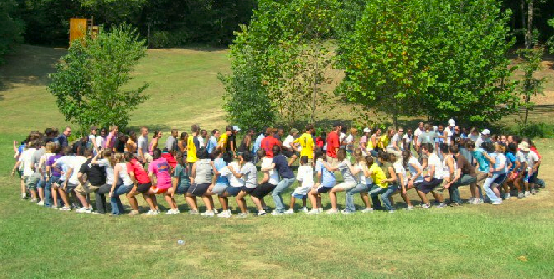
Peace is a human right
Christophe Barbey, APRED, IPRA 2014

Slide 5
The human right to peace Essentials
The human right to peace is:
Inherent to human nature
Essential for the coordination of all human rights
Proactive towards peaceful conflict management
Easy tool to implement peace:
Regular reports on the progress of peace
Efficient control on any use of force.
Christophe Barbey, APRED, IPRA 2014

Slide 6
Looking forward
The Conflict transformation graphic
© APRED

Slide 7
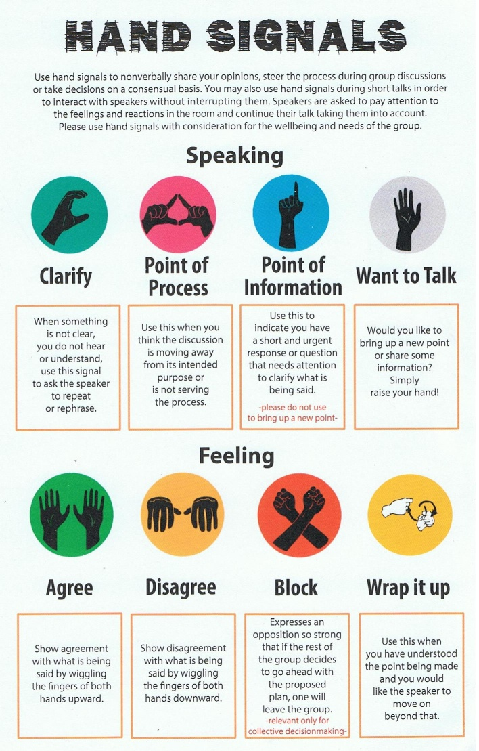
Peace and democracy
Short overview
Democracy is a human right
Rights are empowering
Consensus brings:
decision rights to all
unity
highlights values
Democracy grants more access to constitutional processes
Christophe Barbey, APRED, IPRA 2014

Slide 8
The core of the peace zone :
Harmony and serenity
The outskirt of the zone : Building peace
The peace zone graphic
© APRED
Notes:
Seligman; positive psychology.

Slide 9
Peace and constitutions
Constitutions are locally universal
Universal peace made local.
They are value oriented.
Most of them already mention peace
They have concrete effects.
Peace made effective.
Rates of popular revisions and referendums are increasing
Christophe Barbey, APRED, IPRA 2014

Slide 10
Efficient peace through constitutions
Grant peace as a human rigth (5 countries).
Constitutionnally mainstream peace (and violence prevention) as a prevailing state duties (As gender or environmntal protection).
Uphold peace in civic education. Facilitate dialogue. Grant large rights of participation.
Guarantee access to peaceful conflict-solving methods.
Exercice strict control over the use of force.
Create peace ministries and volunteer services for peace.
Ban war as the UN does (Charter, article 2 § 3 & 4. 5 countries).
Ban the army (15 countries).
Christophe Barbey, APRED, IPRA 2014

Slide 11
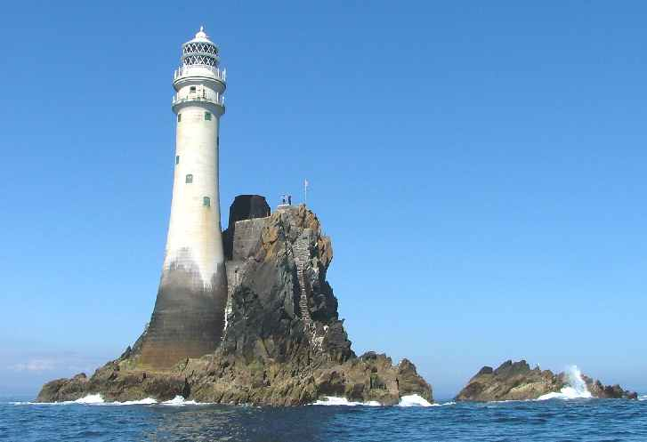
Non-militarisation
Countries without armies
Legal dispostions baning the army
Absence of heavy weapons,
no war missions,
no autonomous military
infrastructures.
Christophe Barbey, APRED, IPRA 2014

Slide 12
Non-militarized countries
Cook Islands
Kiribati
Marshall Islands Micronesia
Nauru
Niue
Palau
Samoa
Solomon Islands Tuvalu
Vanuatu
Costa Rica
Dominica
Grenada
Haiti
Panama
St-Kitts and Nevis
St-Lucia
St-Vincent
Andorra
Iceland
Liechtenstein
Monaco
San Marino
Vatican
Mauritius
Christophe Barbey, APRED, IPRA 2014

Slide 13
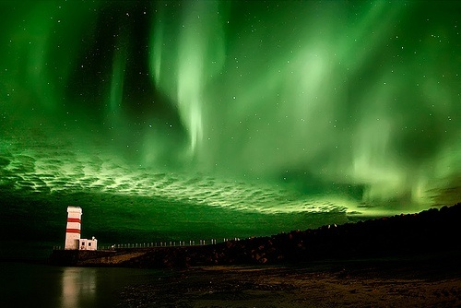
Non-militarisation
26 countries without armies, in the world 1 out of 8.
They all have international recognition as independent.
They are all democratic, but one.
They all make security choices including being army-less.
7 of them have a security treaty with another State.
7 demilitarized, all others were born without armies.
They are all but one members of a regional security organization.
Christophe Barbey, APRED, IPRA 2014

Slide 14
Non-militarisation studies
More research is needed, i.e.:
Peace narratives, lessons learned from non-militarisation.
Major incidents report, to compare with other countries.
There was only 2 major breaches of the rule of law in 20 years.
A gender study as incentives show that the situation of women is better there.
A study on the quality of education.
Again incentives seem to show that
the situation is better.
An economic status study, to compare
with the growth other countries.
Other suggestions? Etc. Etc…
Christophe Barbey, APRED, IPRA 2014

Slide 15
Non-violent States
Final considerations
cb@apred.ch

